Slide 1
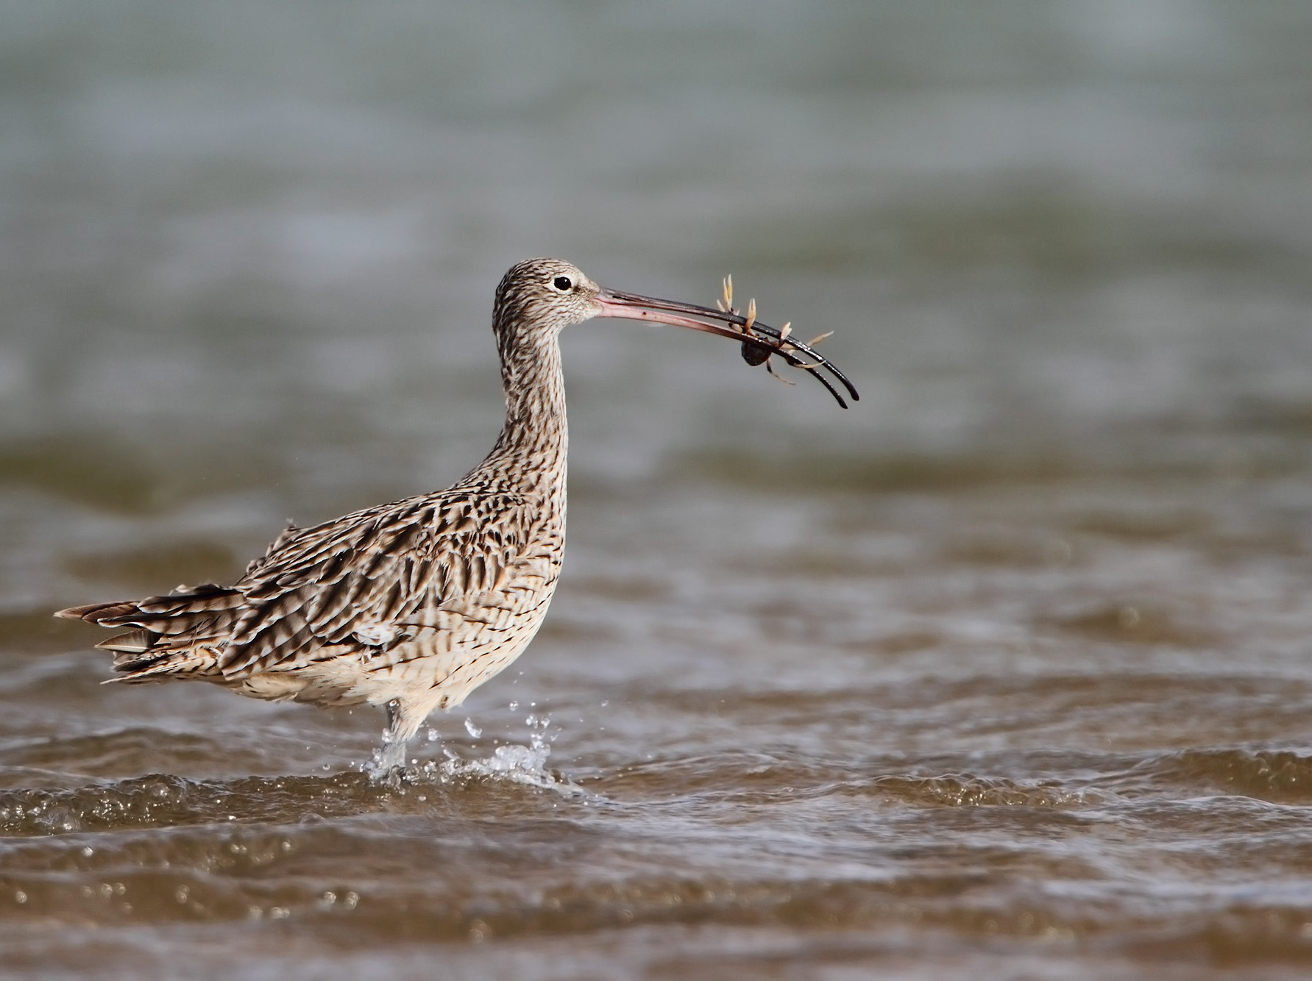
CONS7008
Migratory shorebirds of the East Asian-Australasian Flyway
Prof Richard Fuller

Slide 2


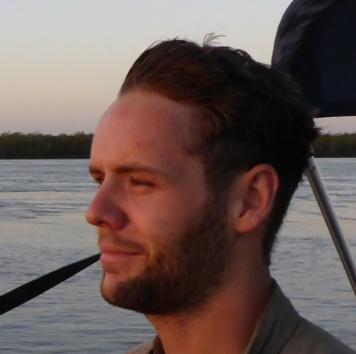
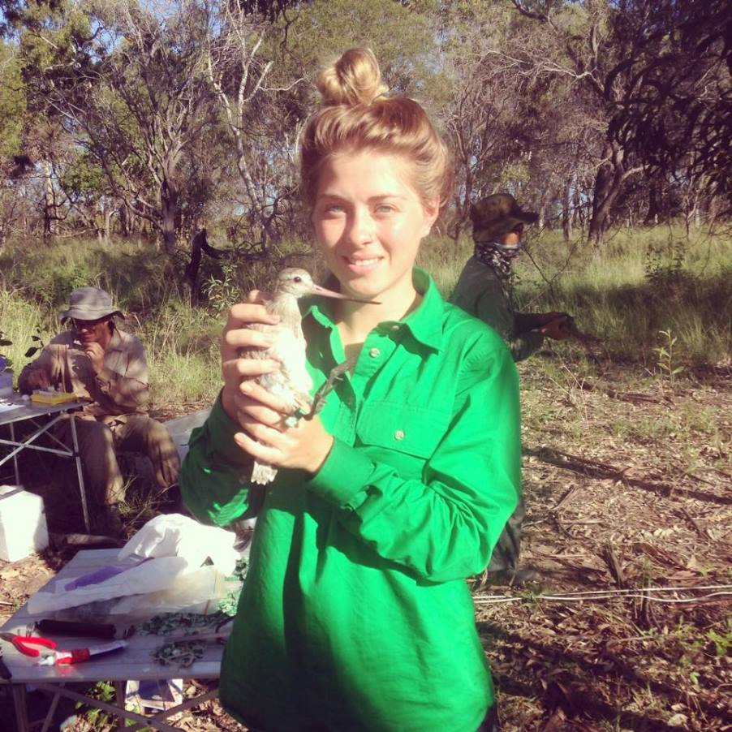
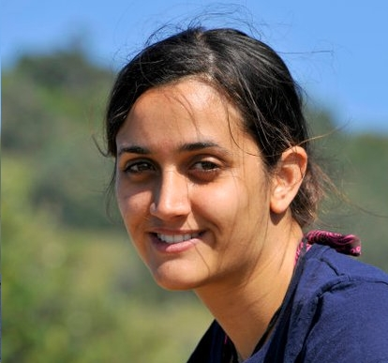


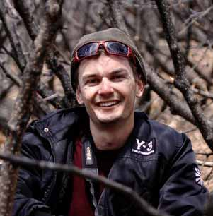



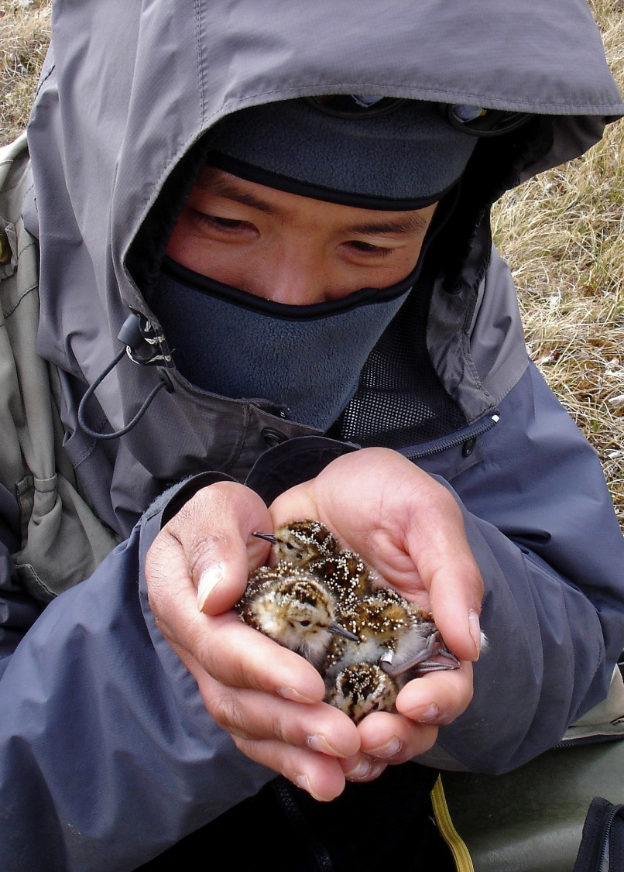
fullerlab.org
fullerlab
Dylan
Maddy
Kiran
Ed
Brad
Sam
Karen
Tak
Micha
Jimmy

Slide 3



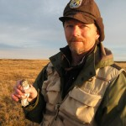
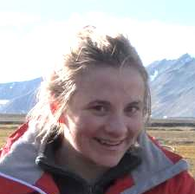

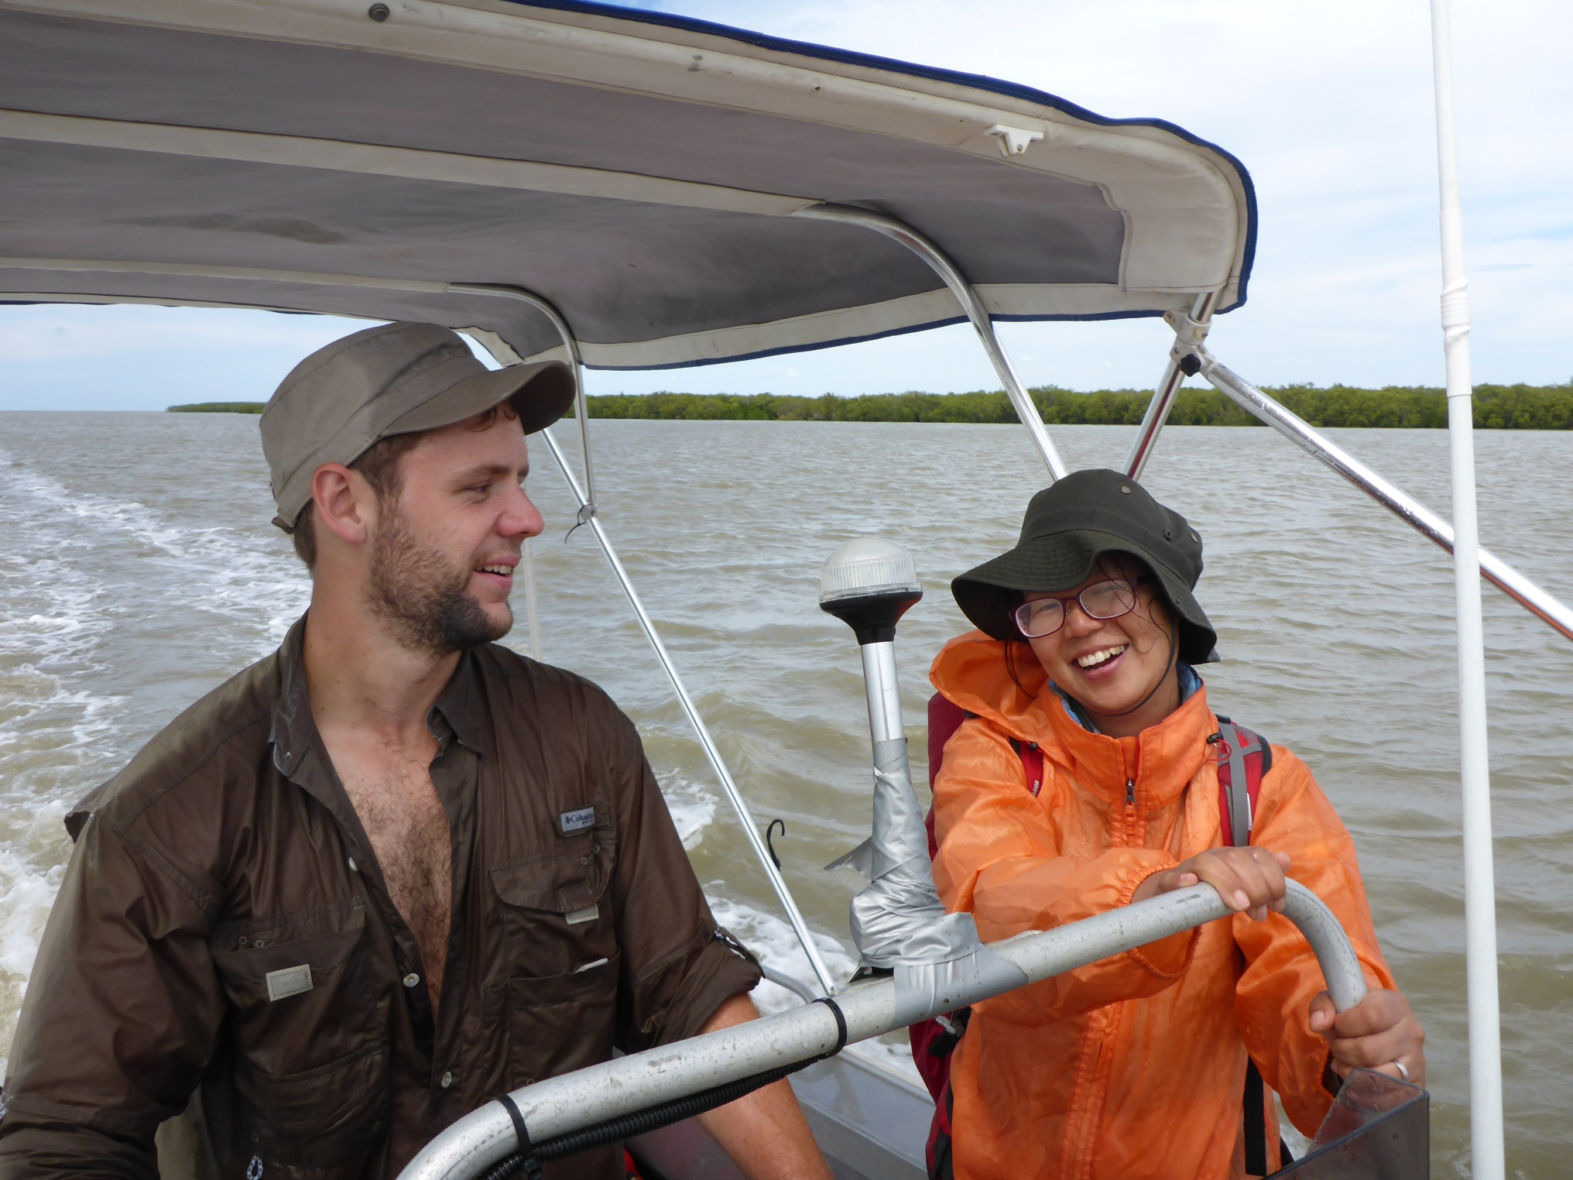
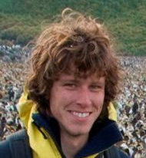
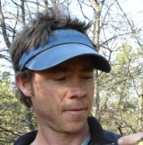

fullerlab.org
fullerlab
Justine
Rob
David
Rick
Hannah
Elena
Mavis
Nick
Colin
Øystein

Slide 4
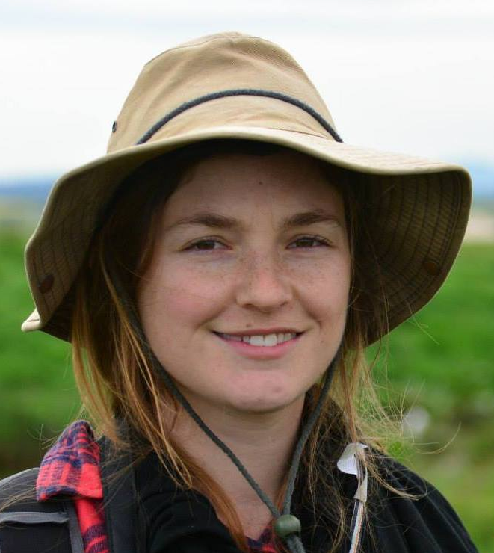




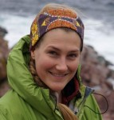




fullerlab.org
fullerlab
Michelle
Jeff
Hsien-Yung
Michael
Claire
Stephanie
Zhijun
Marcel
Richard
Hugh

Slide 5
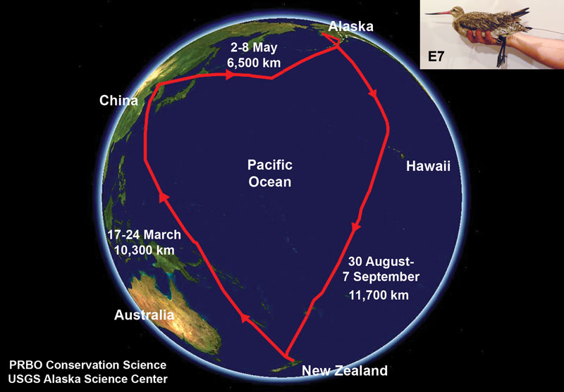
Notes:
Captured at Miranda in Feb 2007, hoping to watch northward migration
PPT transmitter lasted longer than expected
Left on 17th March and flew 10,000km to Yalu Jiang on the Chinese Yellow Sea coast
Refuelled for 5 weeks, then too off on another long flight direct to Alaska (6,500km)
Direct from Alaska back to the same mud flat in New Zealand that it had departed months earlier (11,500km)
30,000km migration

Slide 6
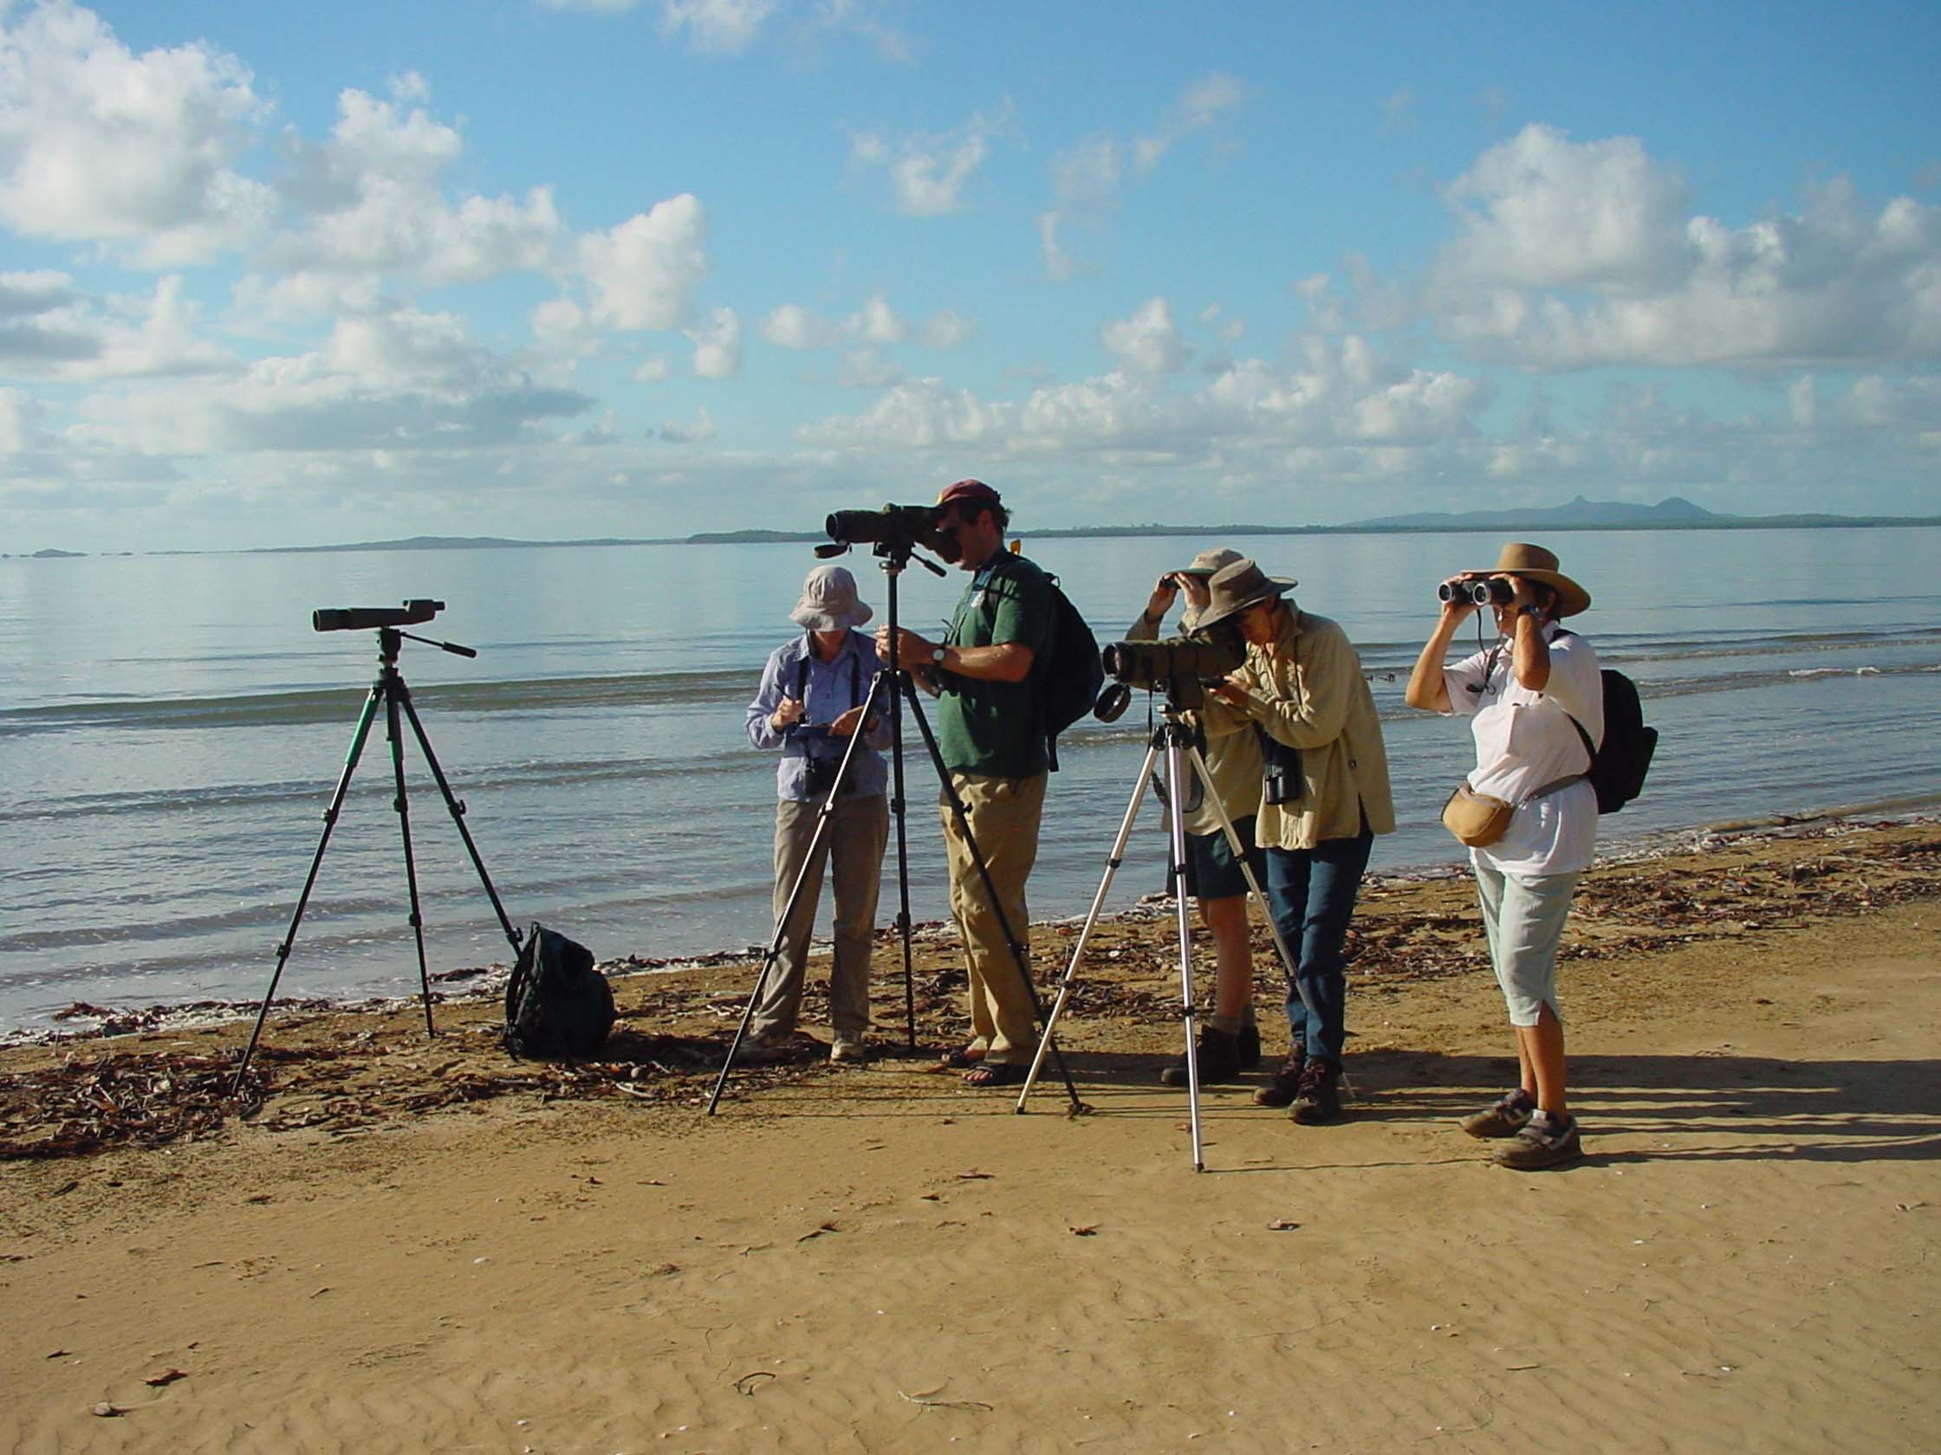
Notes:
ntoives

Slide 7
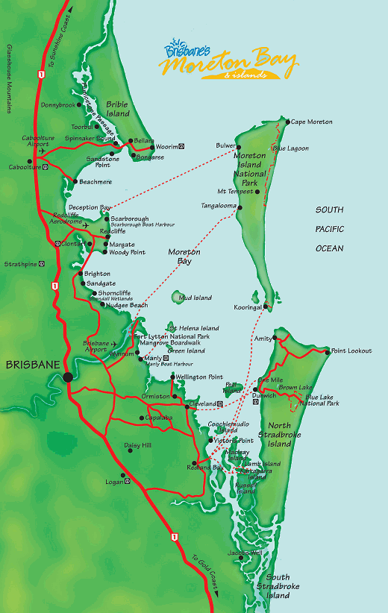
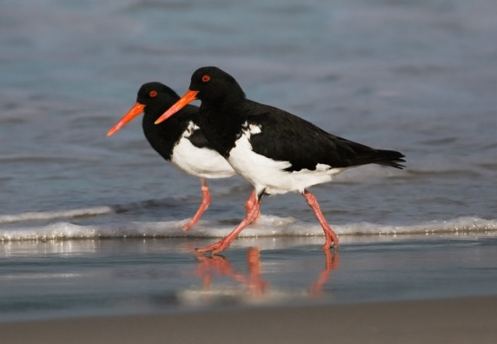
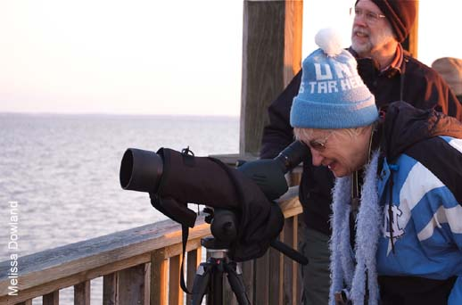

Volunteer counters
Many sites in Moreton Bay
For 20 years

Slide 8
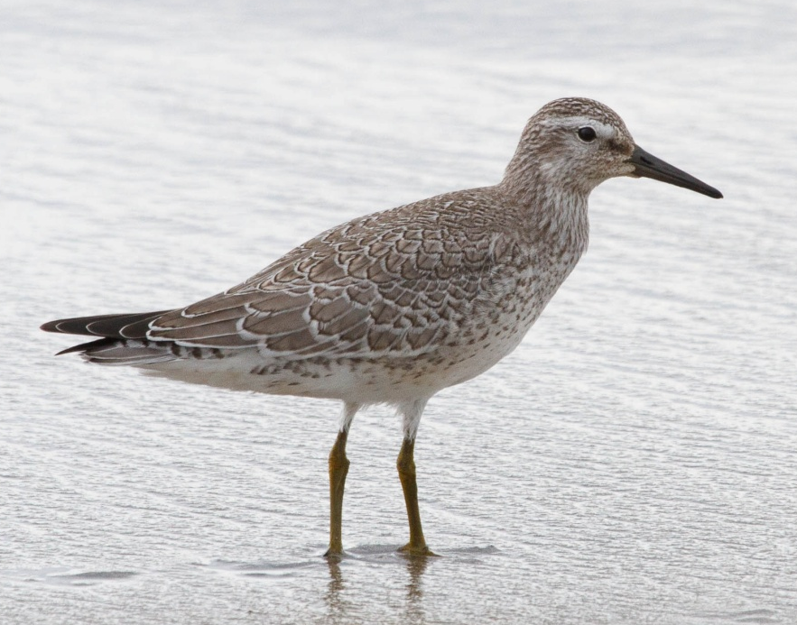
Wilson et al. 2011. Conservation Biology, 25, 758-766.
Notes:
Red knot

Slide 9
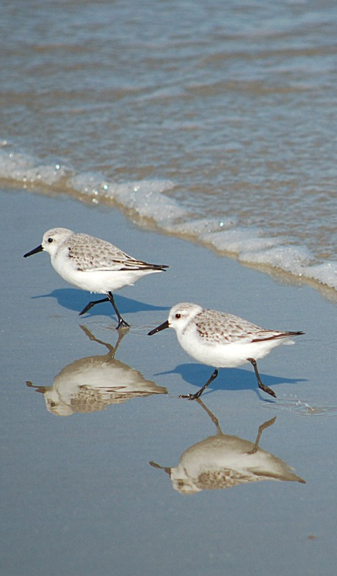
Moreton Bay’s migrant shorebirds are in freefall
Red Knot -8.9%
Bar-tailed Godwit -6.9%
Ruddy Turnstone -6.8%
Greenshank -5.8%
Great Knot -4.5%
Whimbrel -4.1%
All resident species:
No decline (random walk)
Wilson et al. 2011. Conservation Biology, 25, 758-766.

Slide 10




Australasian Wader Studies Group
Birdlife Australia
Birdlife Australia Western Australia
Birdlife Tasmania
BOCA
Friends of Shorebirds SE
Friends of Streaky Bay District Parks
Hunter Bird Observers Club
Japan Bird Research Association
New South Wales Wader Study Group
Ornithological Society of New Zealand
Queensland Wader Study Group
South Australian Ornithological Association
Victorian Wader Study Group

Slide 11
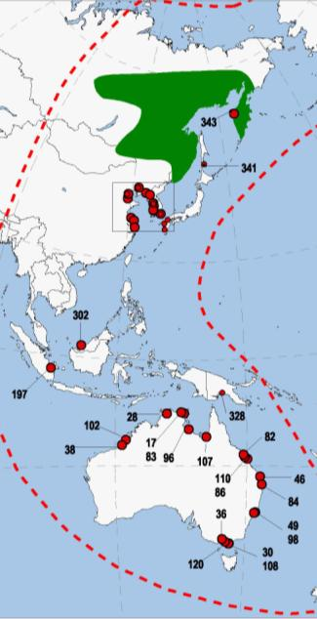
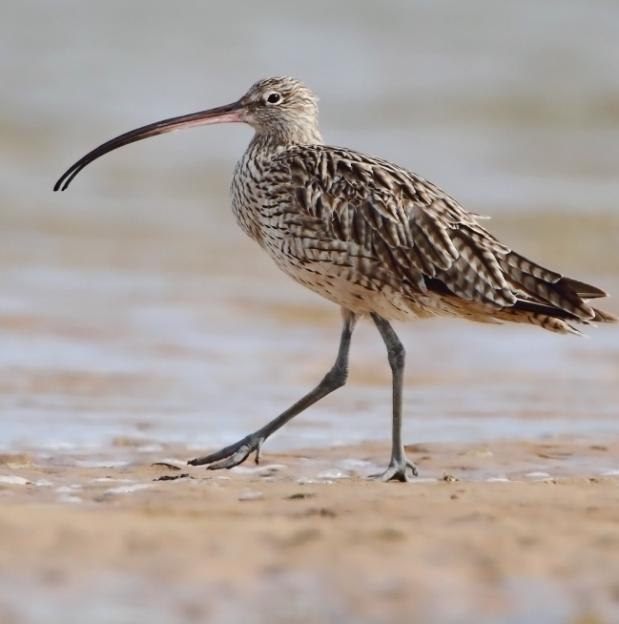
Eastern Curlew
1
100
2
1
2
3
27
6
5
59
4
5
6
7
4
14
8
6
5
7
8

Slide 12
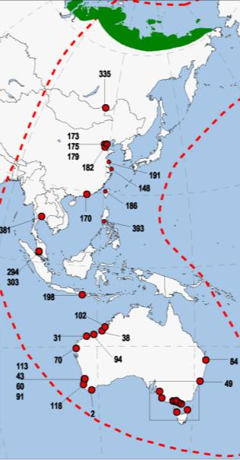
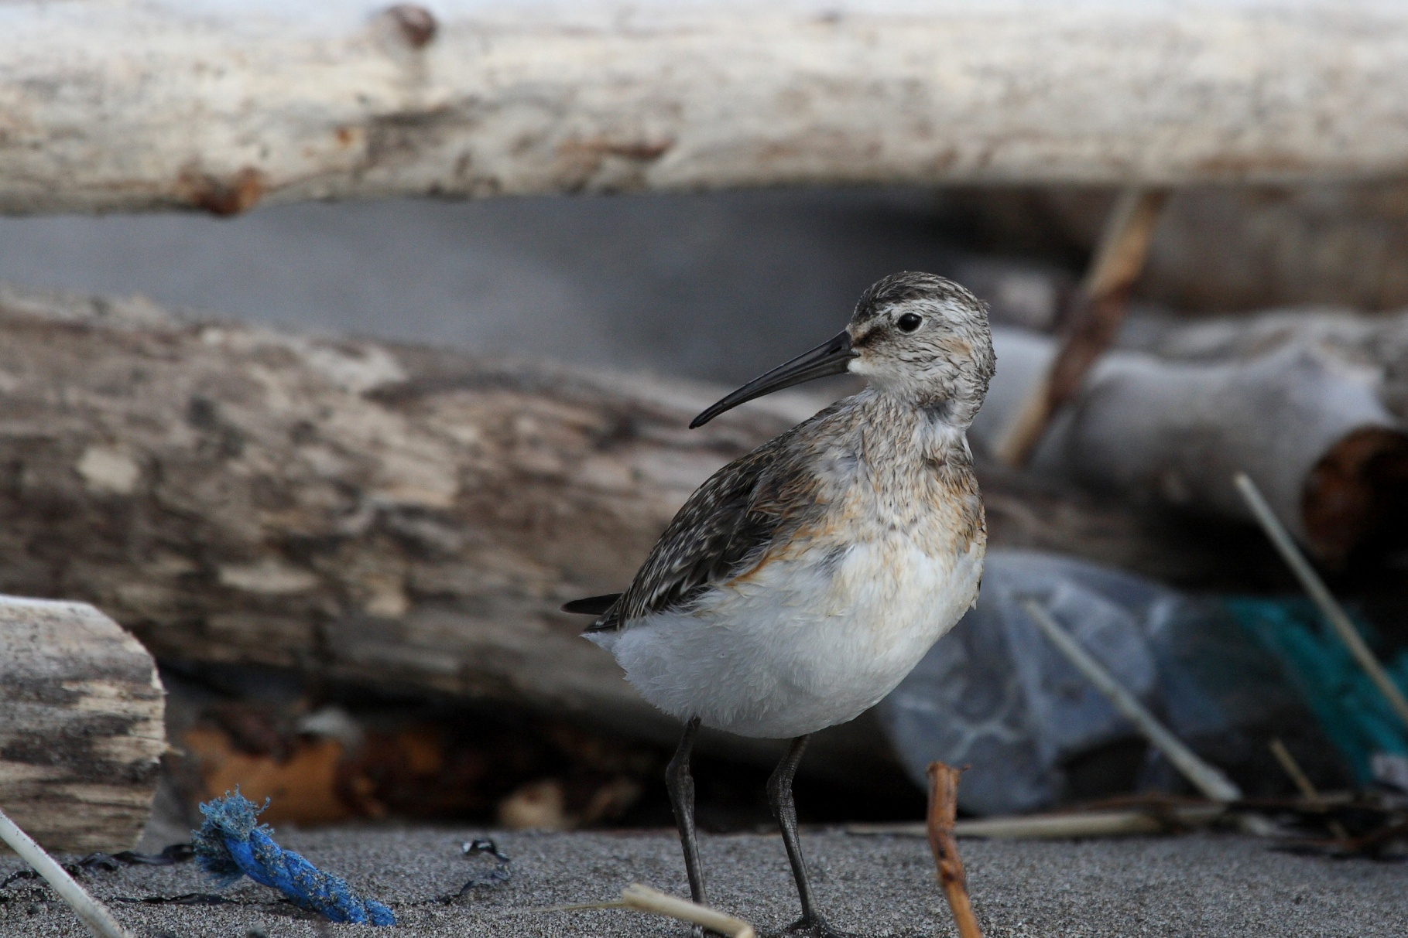
1
1
80
20
2
2
3
3
100
100
4
4
(50)
5
(50)
5
60
6
8
2.6
8.7
43.4
6
7
8
9
7
9
Curlew Sandpiper

Slide 13
Curlew sandpiper
1
80
20
6
2
8
3
100
7
100
9
4
(50)
5
(50)
60
6
2.6
8.7
43.4
7
8
9

Slide 14
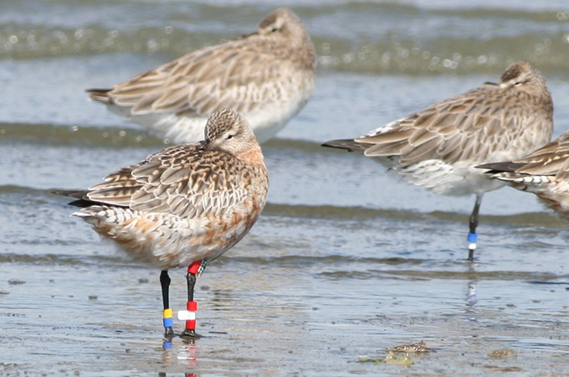
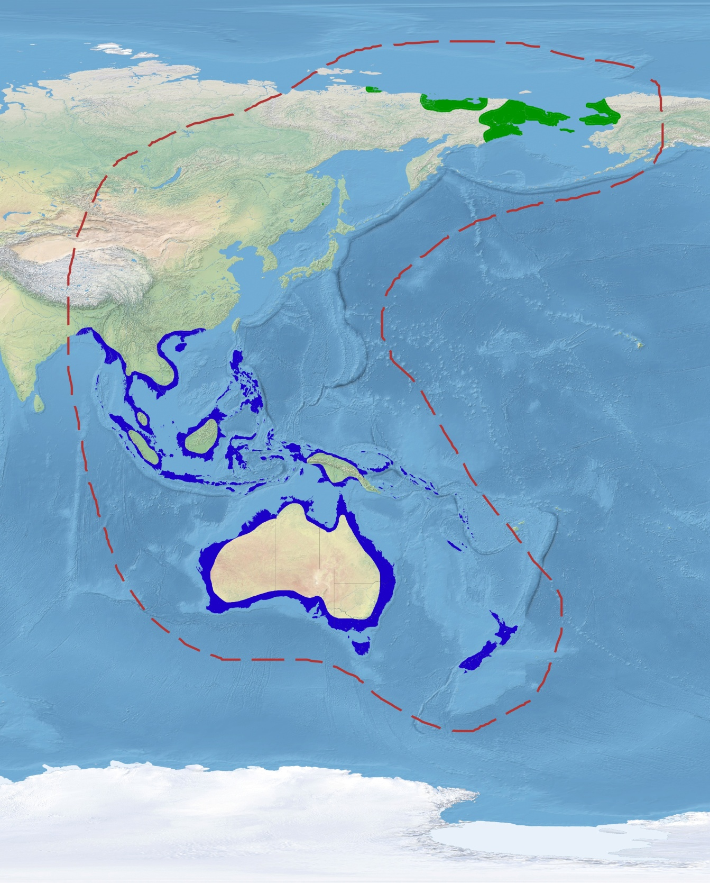
Where do we look to diagnose decline?

Slide 15
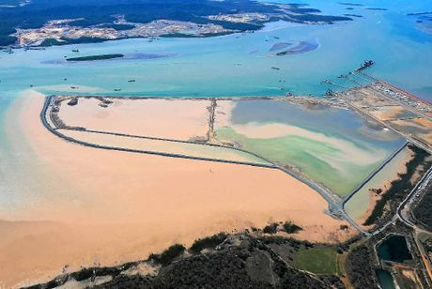

Slide 16
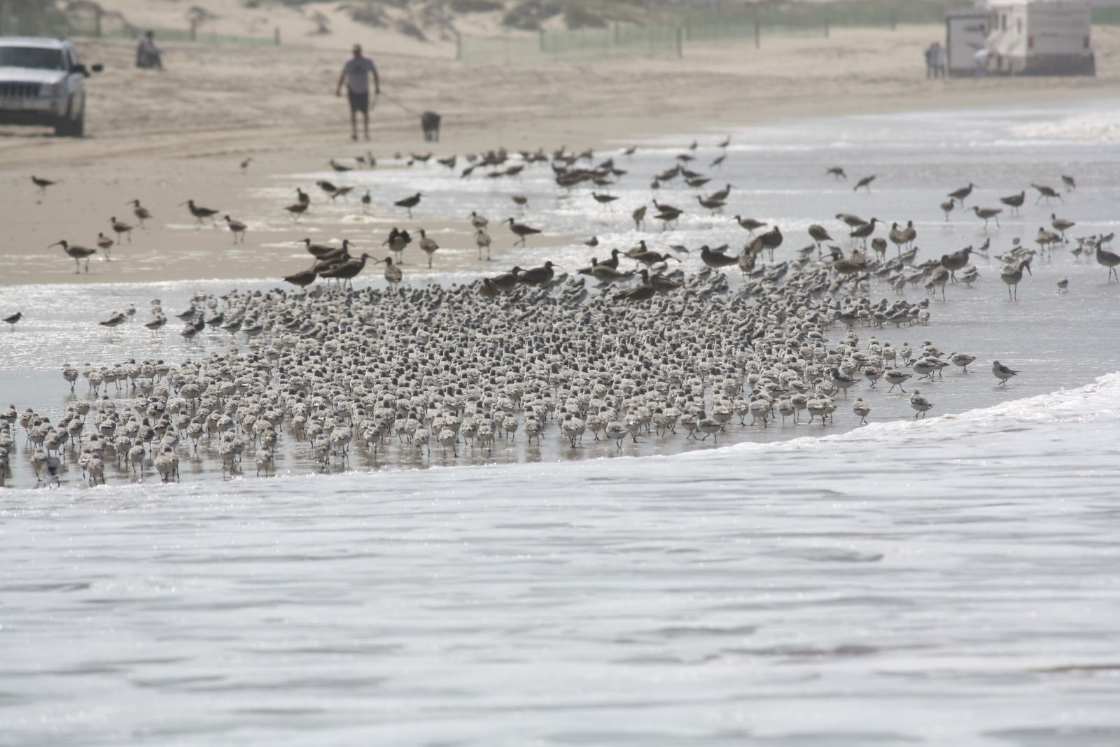

Slide 17
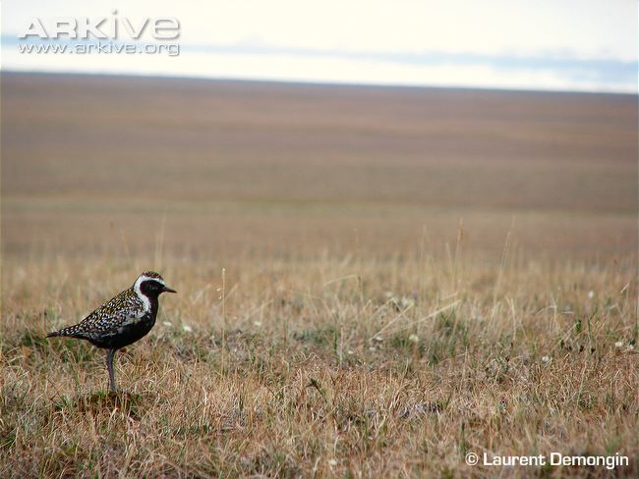

Slide 18
Questions
Where do suitable climatic conditions occur now?
Will climate change shift them?
Where will they be in the future?
How much will be left?
Non-statistical questions

Slide 19
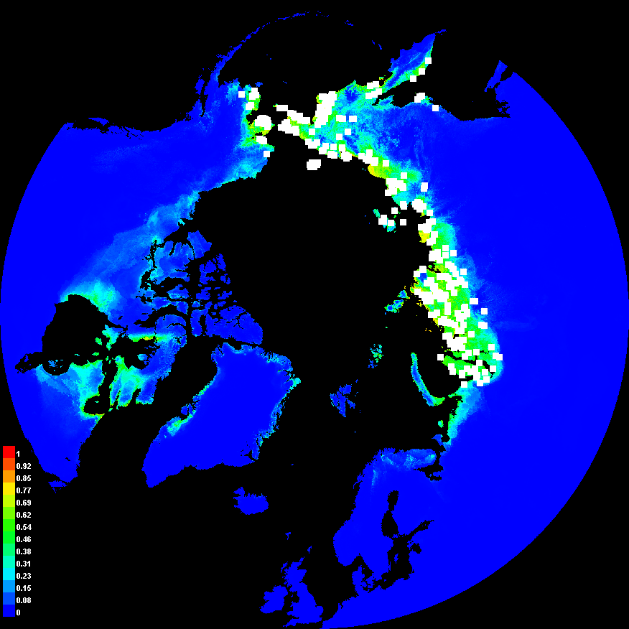
2010
Hannah

Slide 20
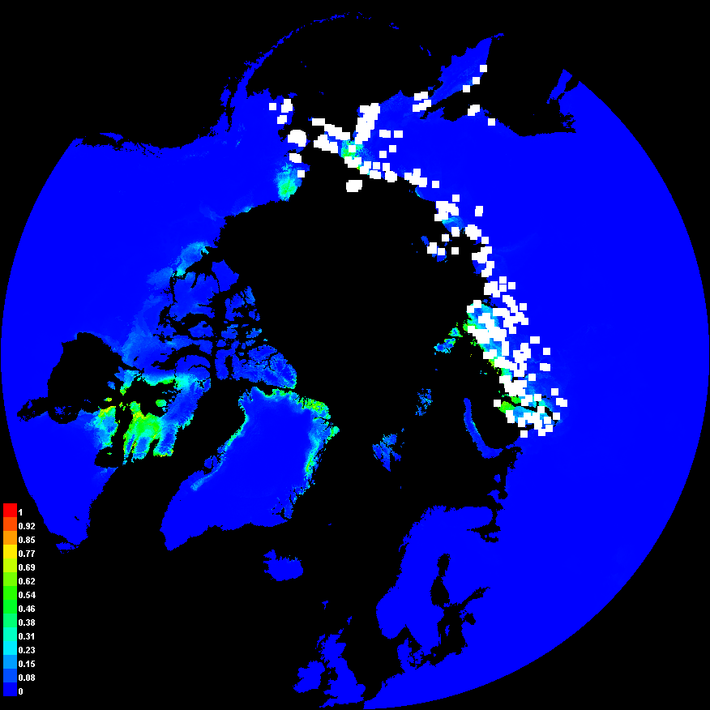
2070
Hannah

Slide 21
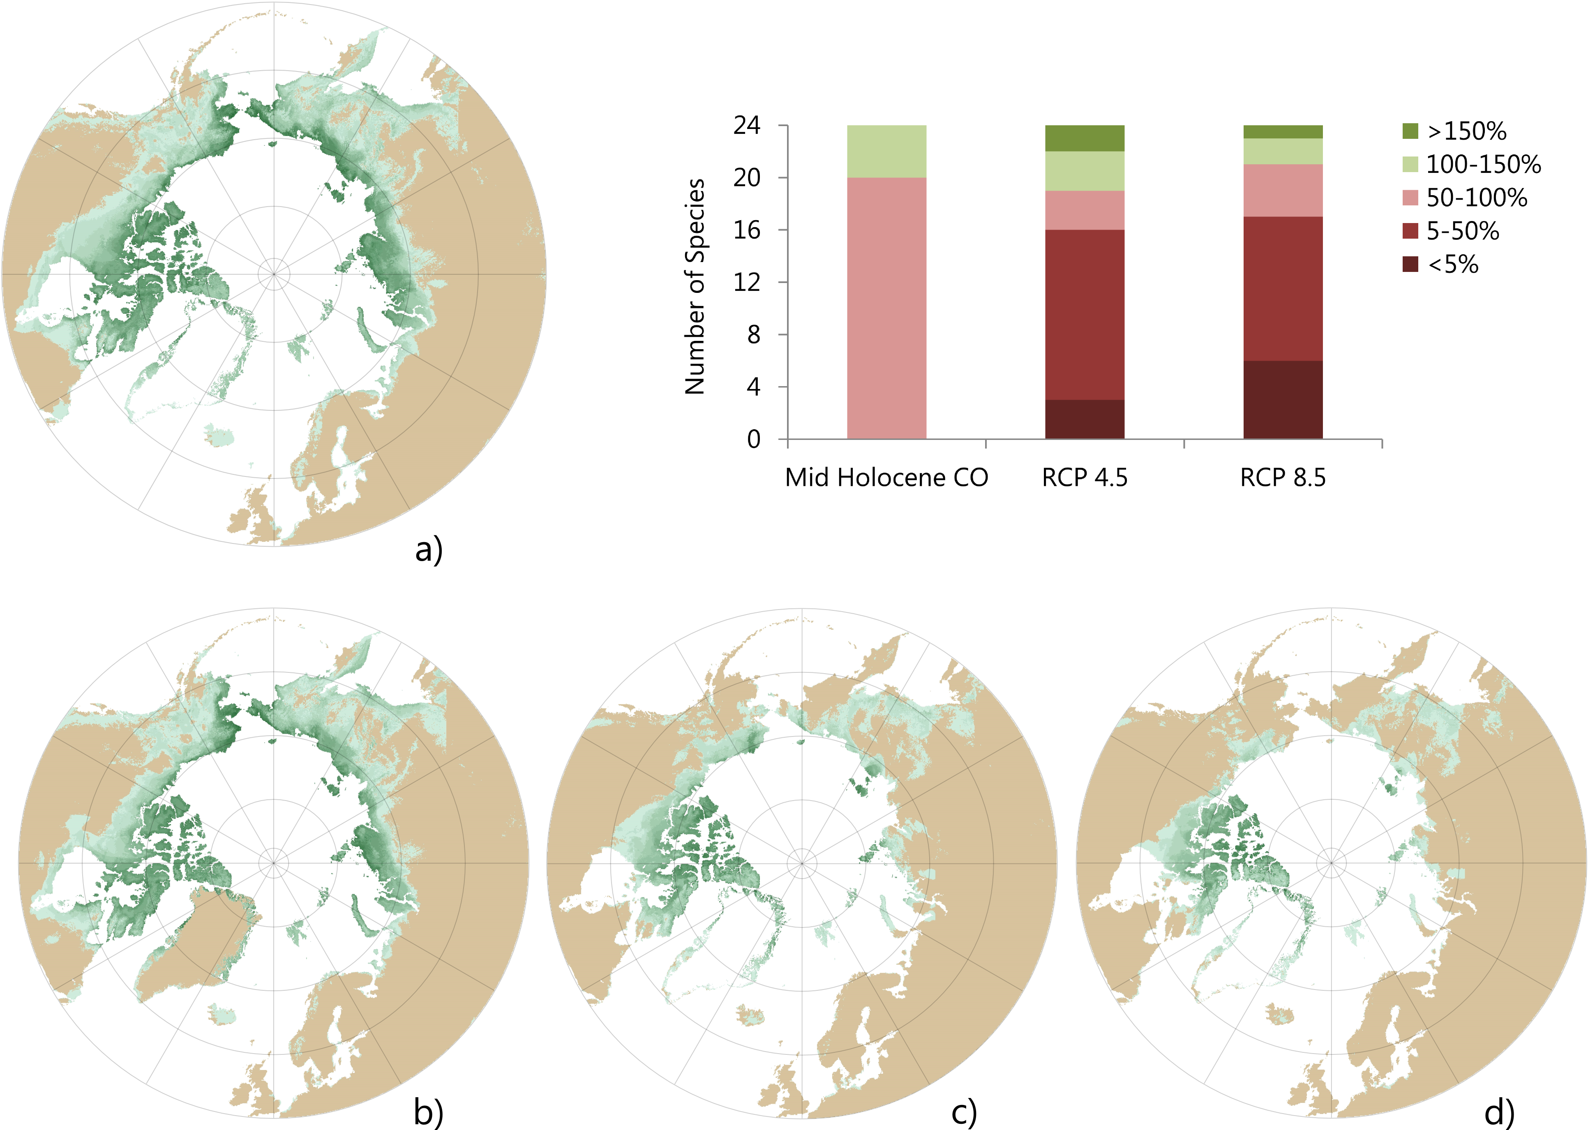
2010
Hannah
Wauchope et al (2017) Global Change Biology.

Slide 22
2070
Hannah
Wauchope et al (2017) Global Change Biology.

Slide 23
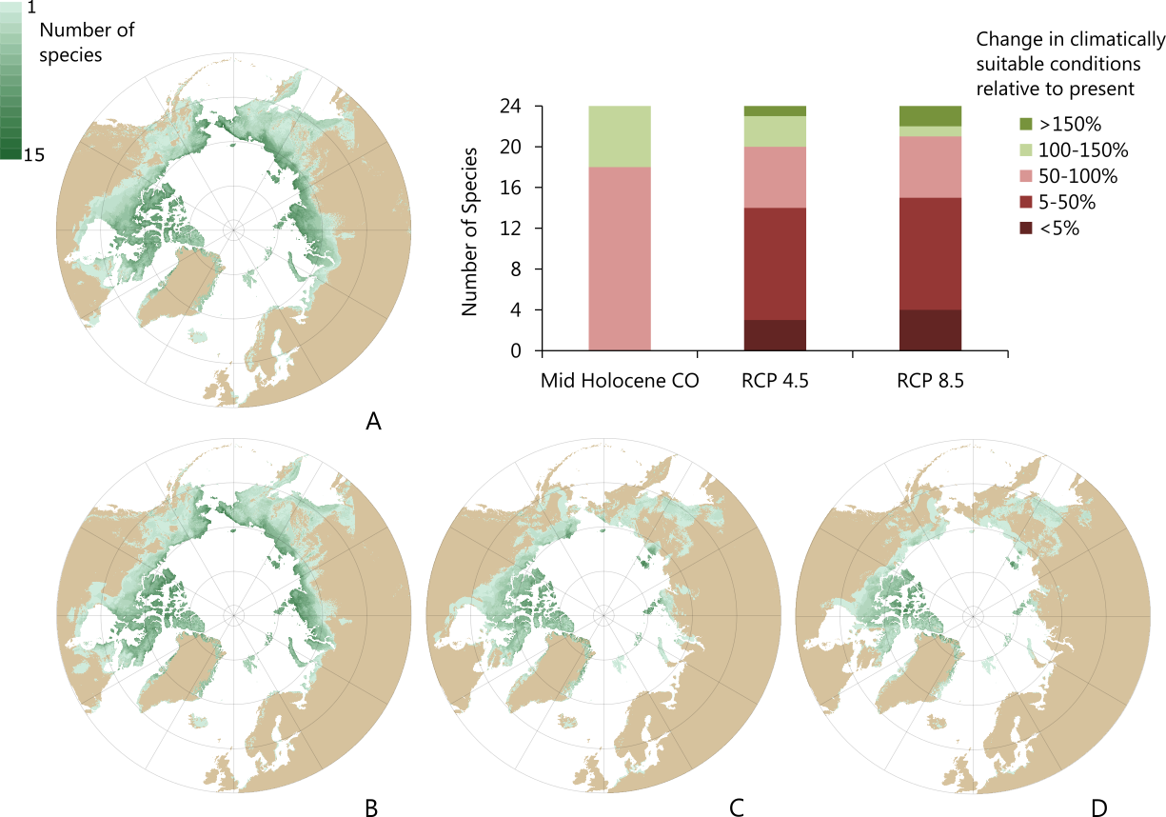
Climate disruption
Current
Mid-Holocene
RCP 4.5
RCP 8.5

Slide 24
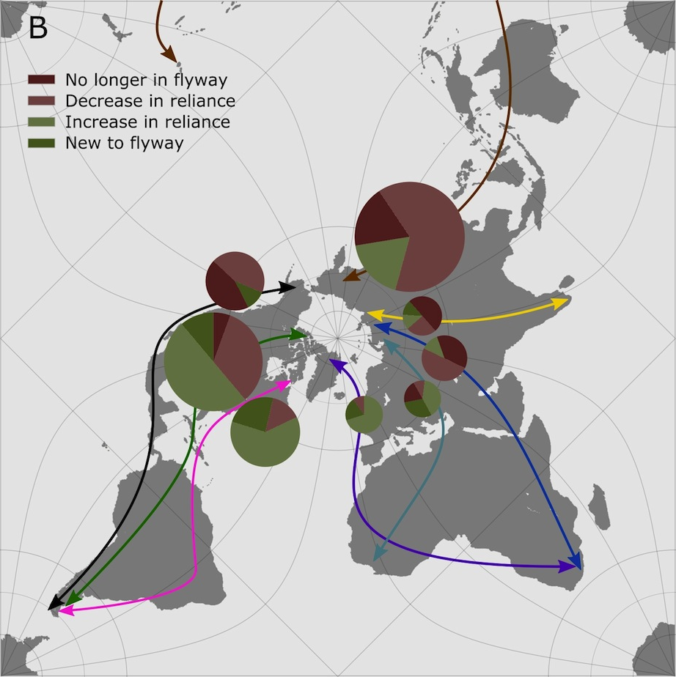

Slide 25
Eastern Curlew
1
100
2
1
2
3
27
6
5
59
4
5
6
7
4
14
8
6
5
7
8

Slide 26
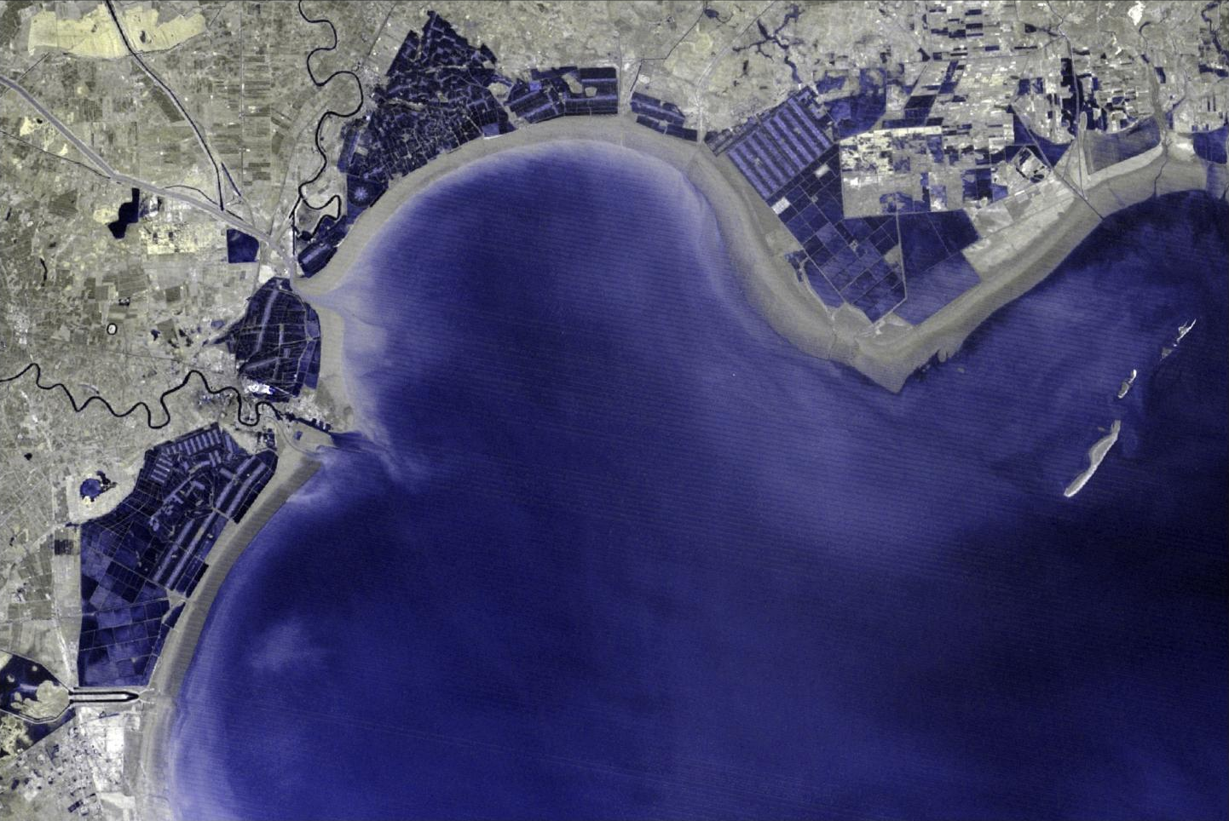
1975: Low Tide
Notes:
1975 image – grey is mudflat – note I can’t classify this yet because we have no water index for it.

Slide 27
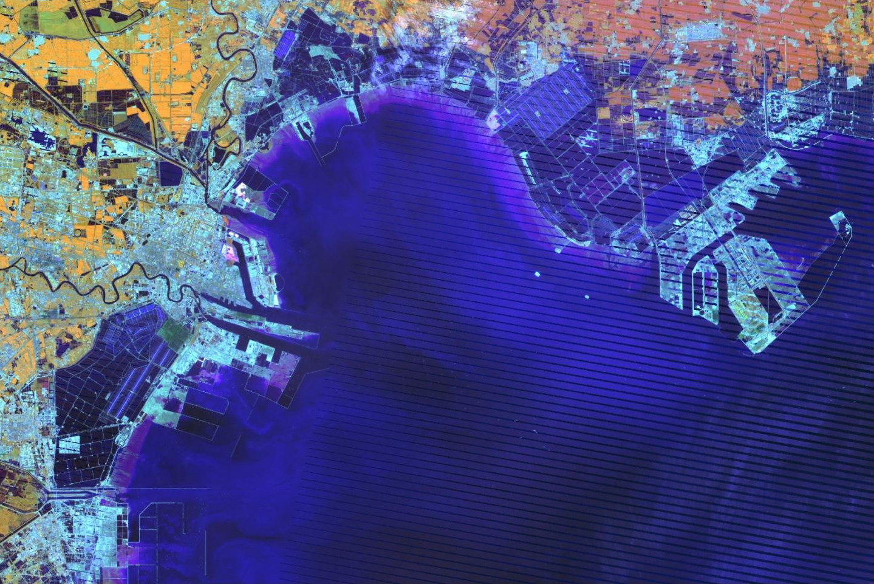
2010: Low Tide
Notes:
2010 (current low tide)

Slide 28
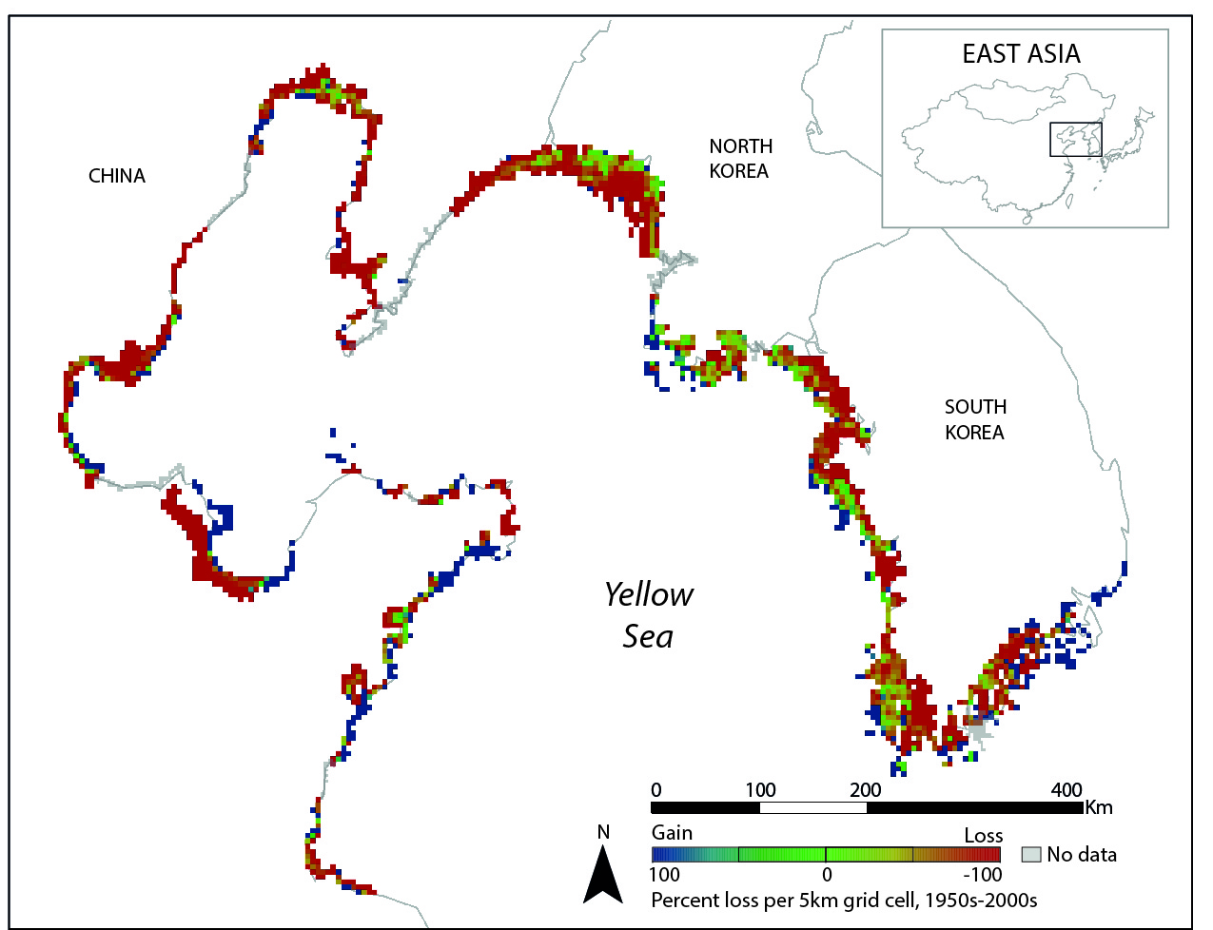
Tidal flats have disappeared in the Yellow Sea

Slide 29
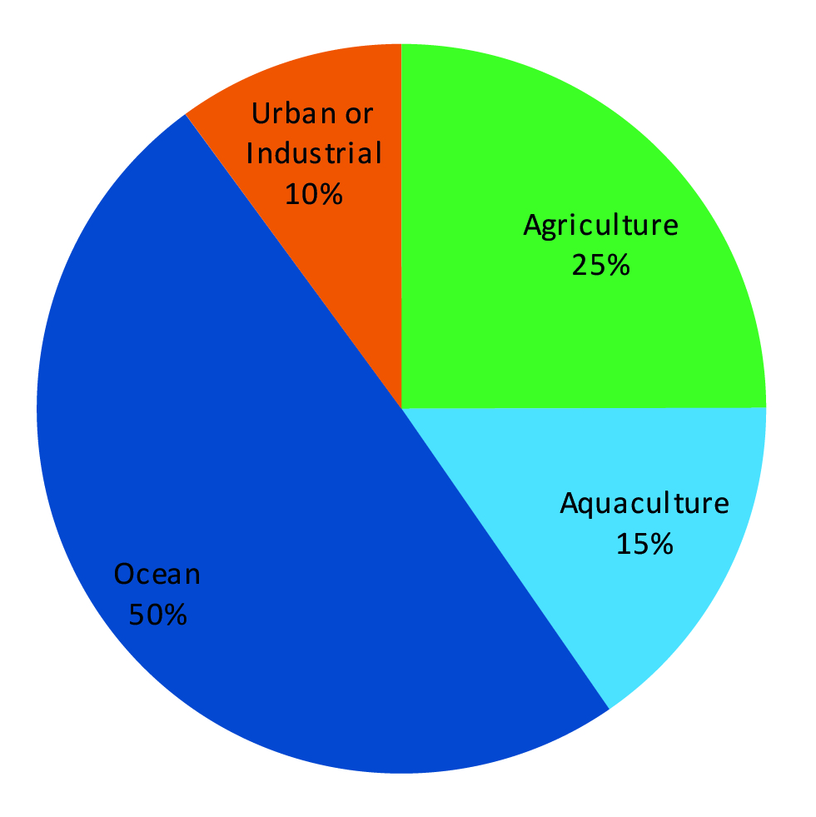
Murray et al. 2014. Front Ecol Environ, 12, 267-272.

Slide 30

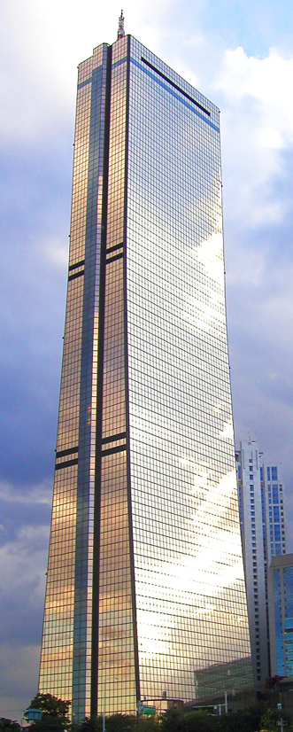

Notes:
All under creative commons from wikipedia

Slide 31
Is habitat loss in the Yellow Sea causing the decline??
1
100
2
1
2
3
27
6
5
59
4
5
6
7
4
14
8
6
5
7
8

Slide 32
Questions
Which shorebird species are declining in Australia, and by how much
Do they qualify as threatened species?
Are the declines happening everywhere?
Are Yellow Sea species declining more quickly?
Heavily statistical question

Slide 33
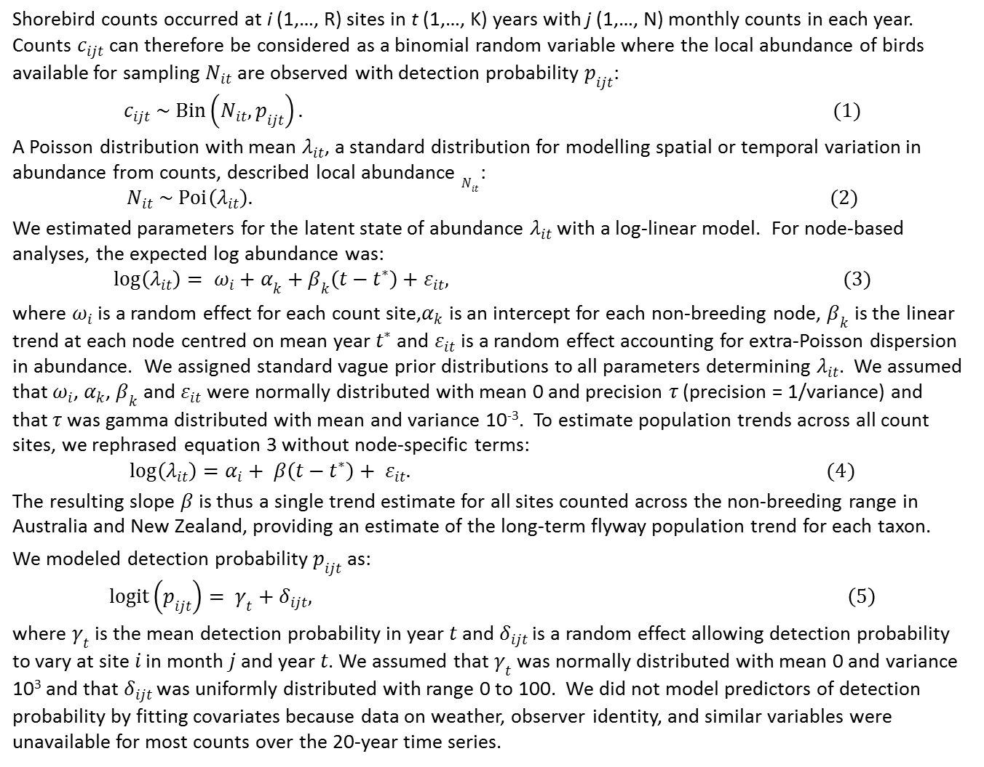
Shorebird counts occurred at i (1,…, R) sites in t (1,…, K) years with j (1,…, N) monthly counts in each year. Counts $c_{ijt}$ can therefore be considered as a binomial random variable where the local abundance of birds available for sampling $N_{it}$ are observed with detection probability $p_{ijt}$:
$$c_{ijt} \sim Bin\left(N_{it}, p_{ijt}\right). (1)$$
A Poisson distribution with mean $λ_{it}$, a standard distribution for modelling spatial or temporal variation in abundance from counts, described local abundance $N_{it}$:
$$N_{it} \sim Poi\left(λ_{it}\right). (2)$$
We estimated parameters for the latent state of abundance $λ_{it}$ with a log-linear model. For node-based analyses, the expected log abundance was:
$$\log\left(λ_{it}\right)= {ω_{i}+α}_{k}+β_{k}\left(t−t^{∗}\right)+ε_{it}, (3)$$
where $ω_{i}$ is a random effect for each count site,$α_{k}$ is an intercept for each non-breeding node, $β_{k}$ is the linear trend at each node centred on mean year $t^{∗}$ and $ε_{it}$ is a random effect accounting for extra-Poisson dispersion in abundance. We assigned standard vague prior distributions to all parameters determining $λ_{it}$. We assumed that $ω_{i}$, $α_{k}$, $β_{k}$ and $ε_{it}$ were normally distributed with mean 0 and precision $τ$ (precision = 1/variance) and that$τ$ was gamma distributed with mean and variance 10⁻³. To estimate population trends across all count sites, we rephrased equation 3 without node-specific terms:
$$log\left(λ_{it}\right)=α_{i}+ β\left(t−t^{∗}\right)+ ε_{it}. (4)$$
The resulting slope $β$ is thus a single trend estimate for all sites counted across the non-breeding range in Australia and New Zealand, providing an estimate of the long-term flyway population trend for each taxon.
We modeled detection probability $p_{ijt}$ as:
$$logit\left(p_{ijt}\right)= γ_{t}+δ_{ijt}, \left(5\right)$$
where $γ_{t}$ is the mean detection probability in year $t$ and $δ_{ijt}$ is a random effect allowing detection probability to vary at site $i$ in month $j$ and year $t$. We assumed that $γ_{t}$ was normally distributed with mean 0 and variance 10³ and that $δ_{ijt}$ was uniformly distributed with range 0 to 100. We did not model predictors of detection probability by fitting covariates because data on weather, observer identity, and similar variables were unavailable for most counts over the 20-year time series.

Slide 35
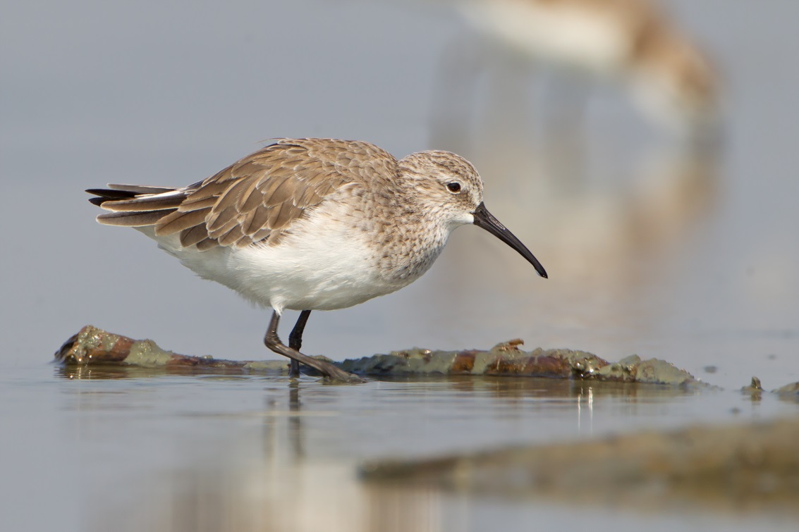
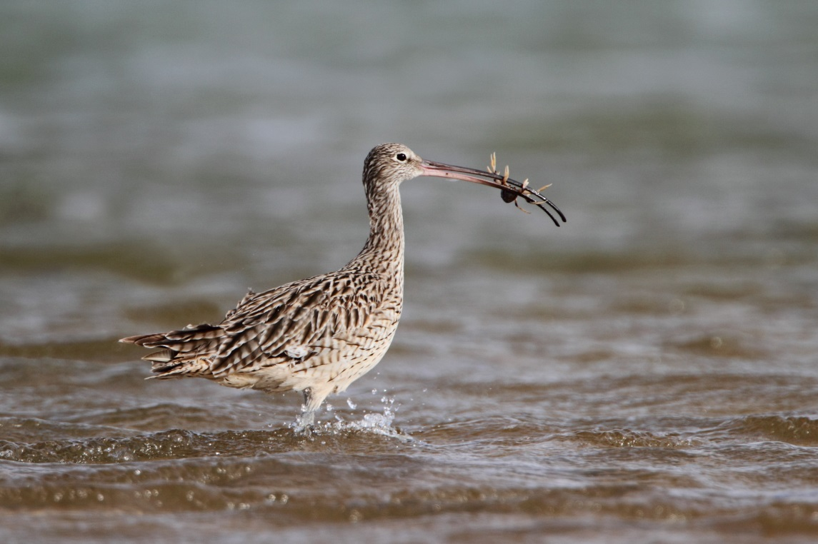

Slide 36
ANZ-wide declines

Slide 37
Declines are happening all around Australia-NZ
 | Node
Taxon | north Western Australia | Queensland | southeastern Australia | New Zealand
eastern curlew | -0.023 (-0.065, 0.020) | -0.052 (-0.069, -0.035) | -0.067 (-0.084, -0.061) | −
curlew sandpiper | -0.019 (-0.088, 0.059) | -0.075 (-0.098, -0.053) | -0.028 (-0.113, -0.052) | −
great knot | -0.057 (-0.096, -0.020) | -0.035 (-0.064, -0.004) | − | −
red knot | -0.044 (-0.095, 0.006) | − | -0.041 (-0.073, -0.007) | -0.042 (-0.069, -0.015)
baueri bar-tailed godwit | − | − | -0.010 (-0.025, 0.004) | -0.015 (-0.024, -0.005)
Terek sandpiper | -0.058 (-0.118, -0.001) | 0.006 (-0.043, 0.053) | − | −
red-necked stint | 0.033 (-0.025, 0.086) | -0.013 (-0.030, 0.004) | 0.018 (0.009, 0.045)
grey-tailed tattler | 0.004 (-0.067, 0.072) | 0.010 (-0.024, 0.042) | − | −
Studds et al. 2017

Slide 38
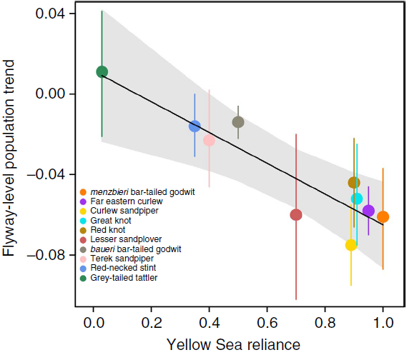
Yellow Sea spp declining more quickly
r² = 0.90, P < 0.001
Studds et al. 2017

Slide 39
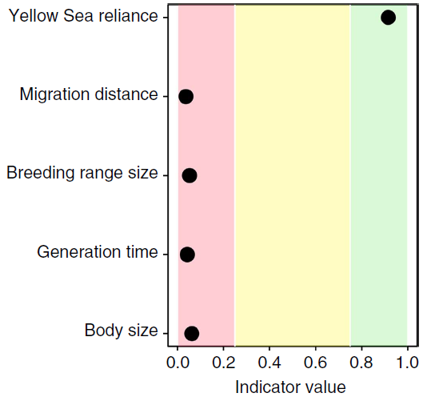
Studds et al. 2017

Slide 40
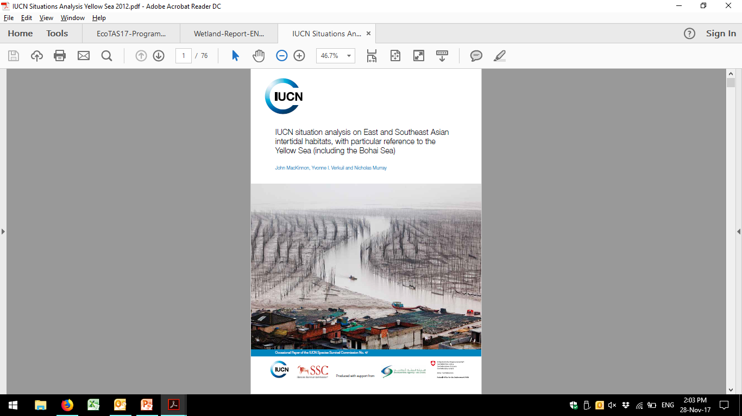
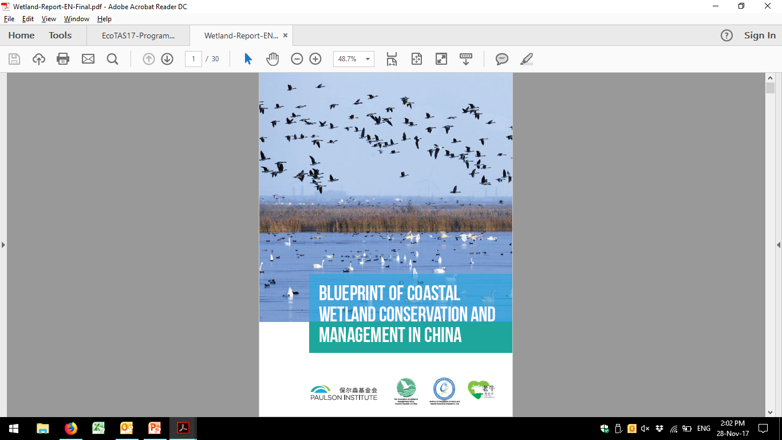

Slide 41
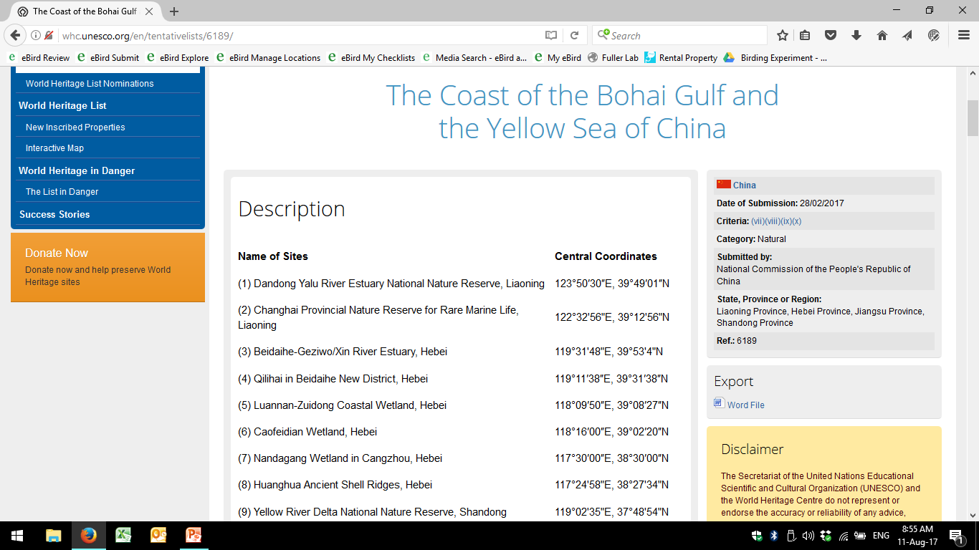
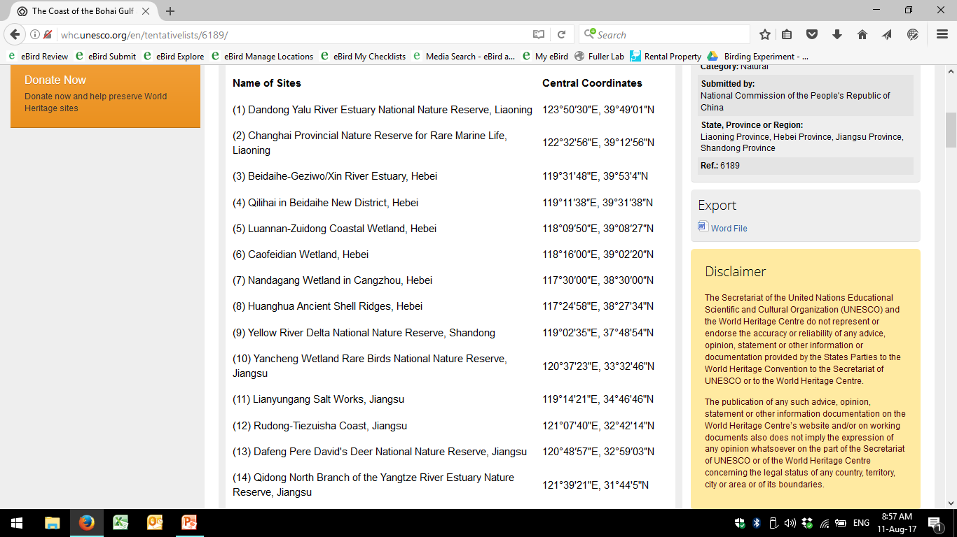

Slide 42


Slide 43

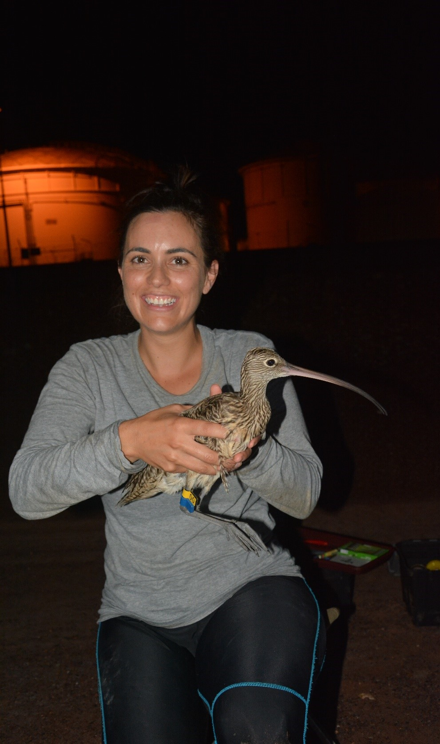
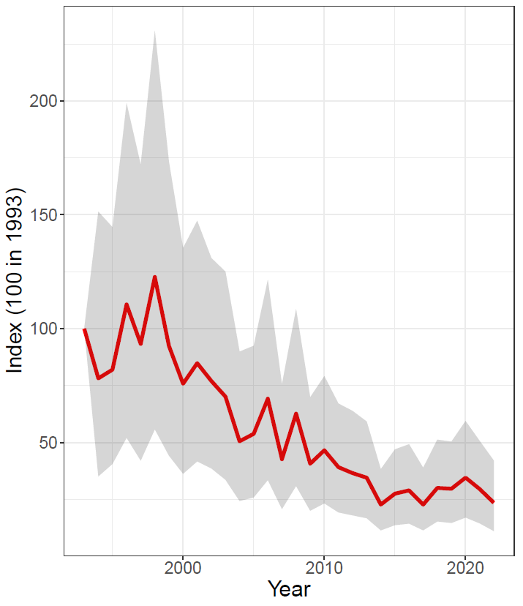
Eastern Curlew

Slide 44
Conservation analyses
We almost always need data
Of various types
We often don’t need stats…
…but we sometimes do
Action transcends analysis!

